Slide 1
Computer Networks
Data and Signal
Subhalaxmi Chakraborty
Email: Subhalaxmi.chakraborty@uem.edu.in
Affiliation: Department of Computer Science and Engineering
University Of Engineering & Management

Slide 2
Communication at the physical layer means exchanging signals.
Data need to transmitted and received but the media have to change data to signal.
Signal can be analog or digital
Analog signal- In this type of signal the amplitudes vary continuously with respect to time.
Digital Signal- In this type of signal the amplitude varies between certain fixed levels.

Slide 3
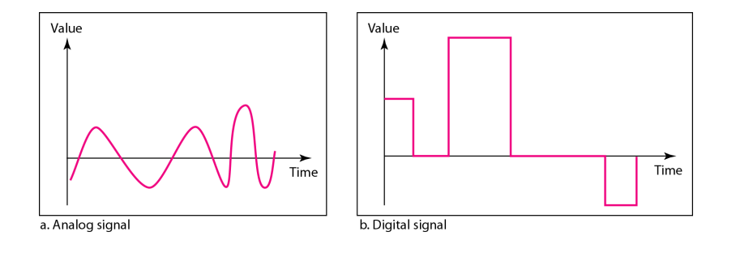
Waveform of Analog and Digital Signal

Slide 4
In data communications, we commonly use periodic analog signals (Sine or cos) and nonperiodic digital signals (11001101010000).
Periodic analog signals can be classified as simple or composite.

Slide 5
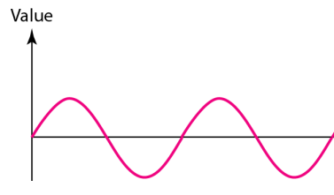

ANALOG SIGNALS
The sine wave is the most fundamental form of a periodic analog signal.
Peak amplitude of a signal is the absolute value of its highest intensity
Unit-(volts)
Period refers to amount of time a signal needs to complete 1 cycle.
Unit-(sec)

Slide 6
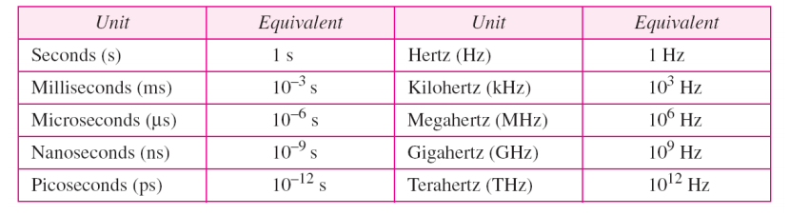
Different units of Time period and frequency

Slide 7
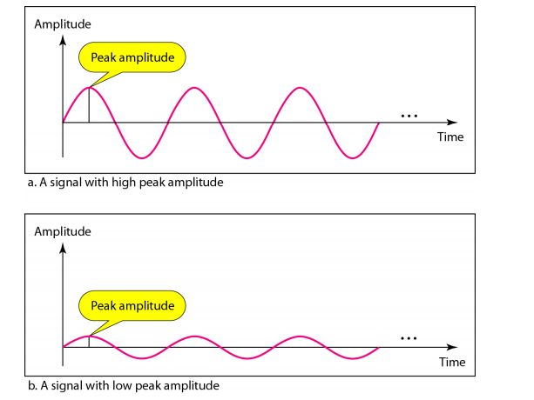

Slide 8
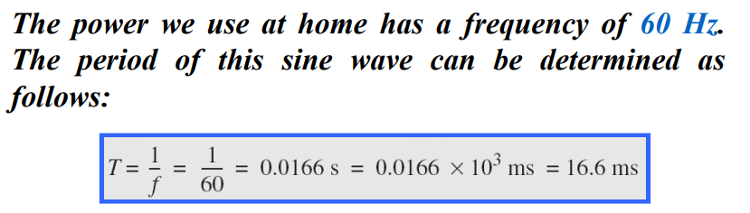
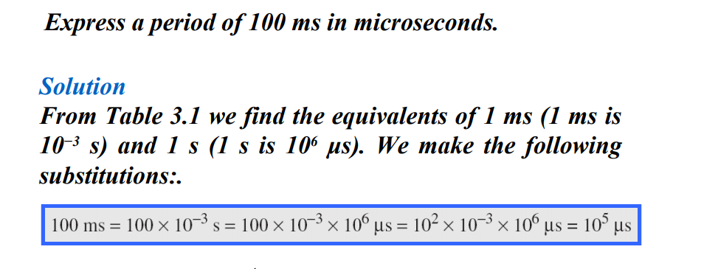

Slide 9
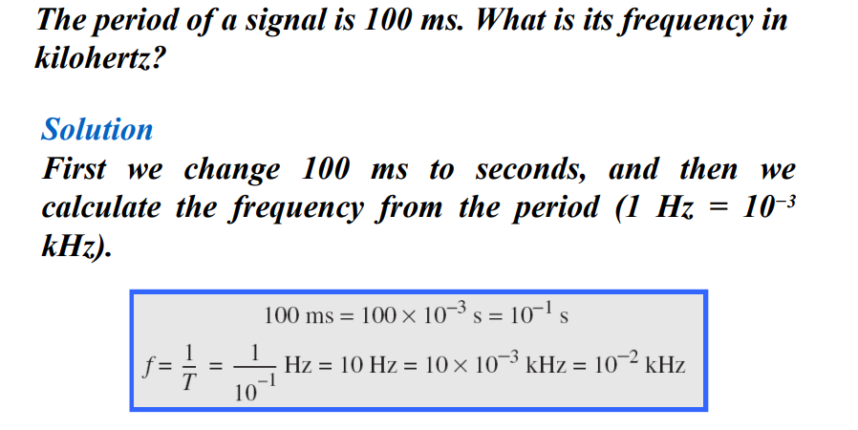

Slide 10
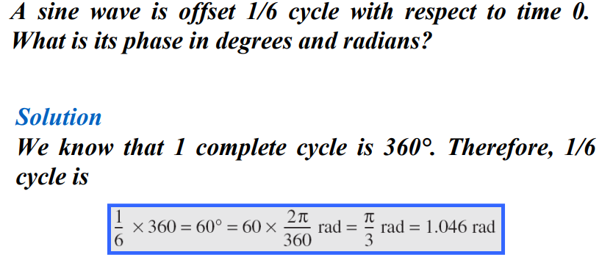

Slide 11
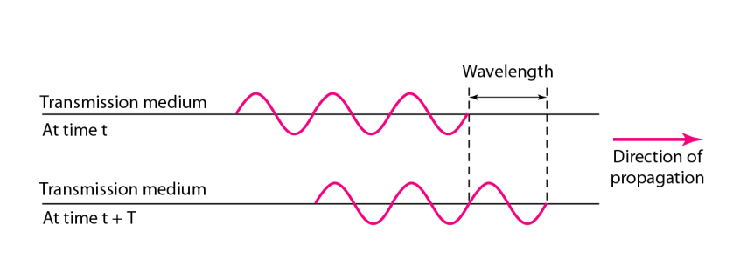
Wavelength

Slide 12
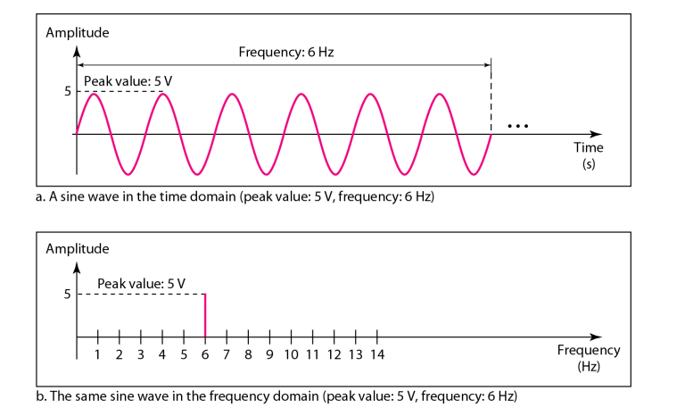
Time-domain and frequency-domain plots of a sine wave
A complete sine wave in the time domain can be represented by one single spike in the frequency domain.

Slide 13
The time domain and frequency domain of three sine waves
composite signal is a combination of simple sine waves with different frequencies, amplitudes, and phases.
Example: Voice Signal

Slide 14
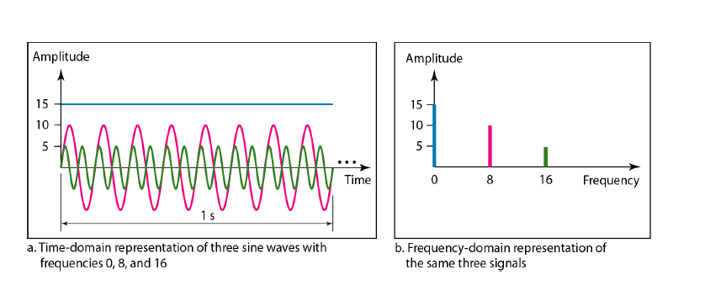

Slide 15
Fourier Analysis
Fourier Series : For Periodic Signal
Fourier Transform: For nonperiodic Signal

Slide 16
If the composite signal is periodic, the decomposition gives a series of signals with discrete frequencies (One fundamental frequency and other harmonics)
if the composite signal is nonperiodic, the decomposition gives a combination of sine waves with continuous frequencies.

Slide 17
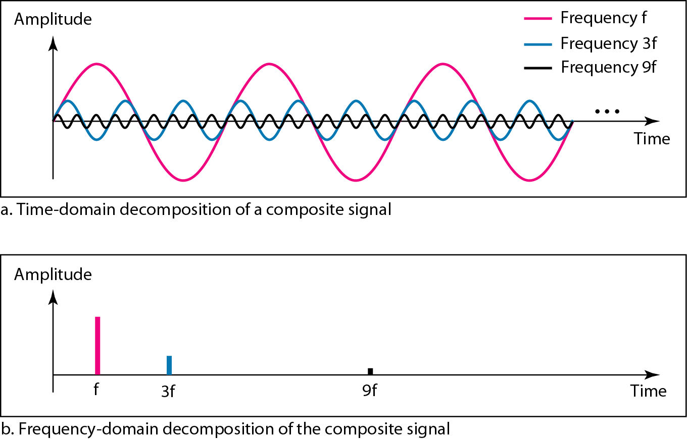
The time and frequency domains of a periodic signal

Slide 18
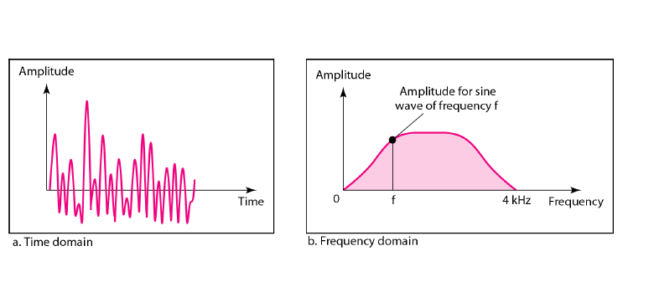
The time and frequency domains of a nonperiodic signal

Slide 19
Bandwidth
Definition-
The bandwidth of a composite signal is
the difference between the highest and the lowest frequencies contained in that signal.

Slide 20
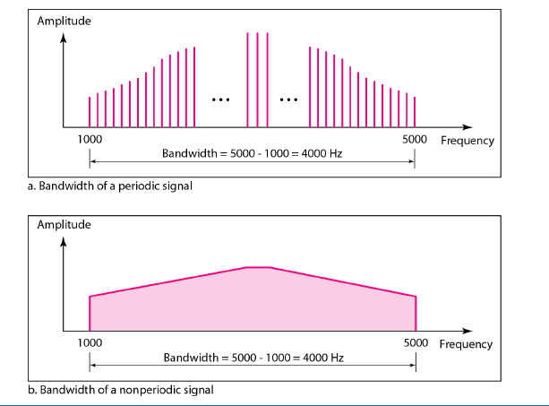

Slide 21
Question
Q1. If a periodic signal is decomposed into five sine waves with frequencies of 100, 300, 500, 700, and 900 Hz, what is its bandwidth? Draw the spectrum, assuming all components have a maximum amplitude of 10 V.
Q2. A nonperiodic composite signal has a bandwidth of 200
kHz, with a middle frequency of 140 kHz and peak
amplitude of 20 V. The two extreme frequencies have an
amplitude of 0. Draw the frequency domain of the
signal.

Slide 22
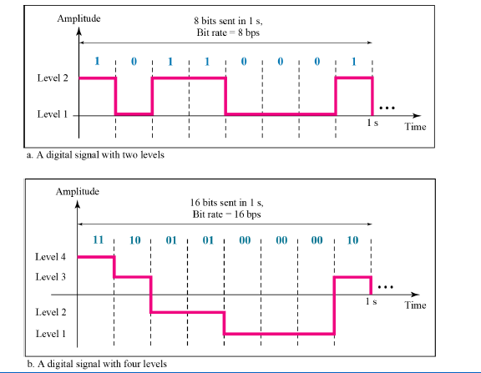
DIGITAL SIGNALS
Two level signal
Multilevel signal

Slide 23
Both Bit rate and Baud rate are generally used in data communication.
Bit rate is the transmission of number of bits per second.
Baud rate is defined as the number of signal units per second.

Slide 24
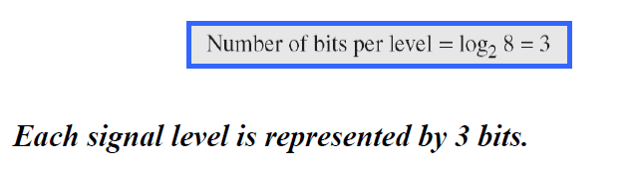
Question
A digital signal has eight levels. How many bits are needed per level?

Slide 25
Question
Q1. A digital signal has nine levels. How many bits are needed per level? We calculate the number of bits.
Q2.Assume we need to download text documents at the rate of 100 pages per minute. What is the required bit rate of
the channel?(Assume 1 page contains 24 lines and each line contains 80 characters

Slide 26
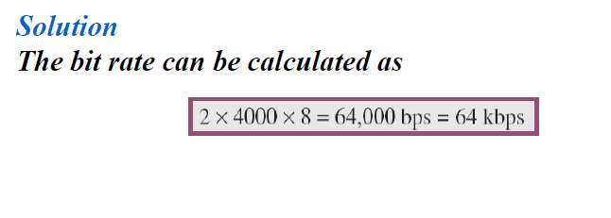
Q3. A digitized voice channel, is made by digitizing a 4-kHz bandwidth analog voice
signal. We need to sample the signal at twice the highest frequency (two samples per hertz). We assume that each sample requires 8 bits. What is the required bit rate?

Slide 27
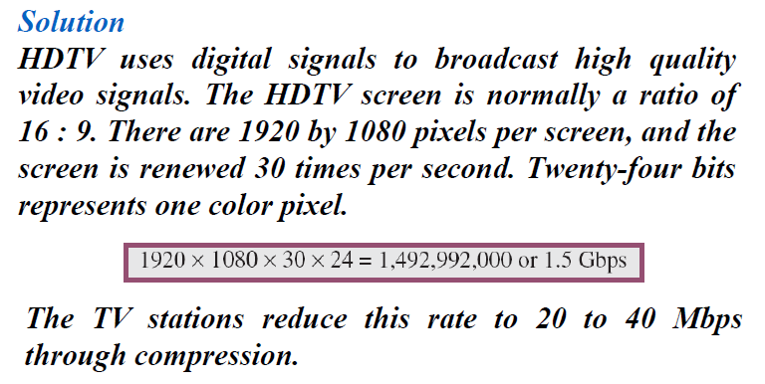
What is the bit rate for high-definition TV (HDTV)?

Slide 28
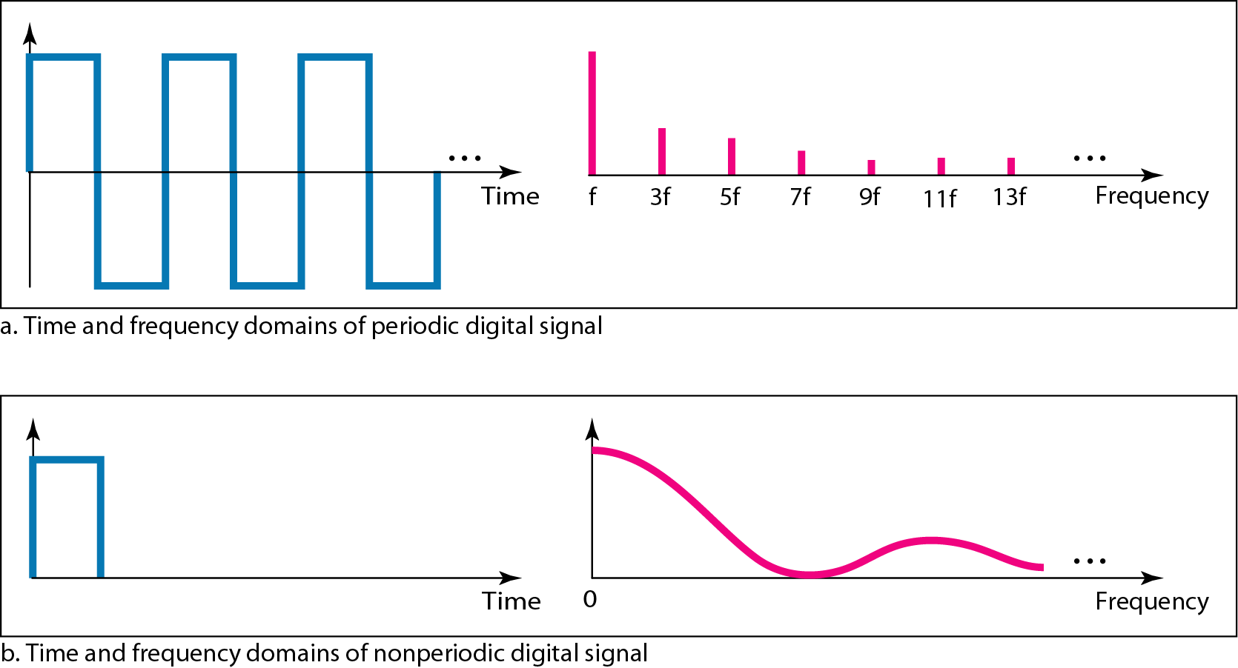
Digital Signal as a Composite Analog Signal
Based on Fourier analysis, a digital signal is a composite analog signal. The bandwidth
is infinite.

Slide 29
Transmission of Digital Signals
Baseband Transmission
Broadband Transmission (Using Modulation)

Slide 30
Transmission Impairments
Signals travel through transmission media, which are not perfect. The imperfection causes signal impairment. This means that the signal at the beginning of the medium is not the same as the signal at the end of the medium.
What is sent is not what is received.

Slide 31
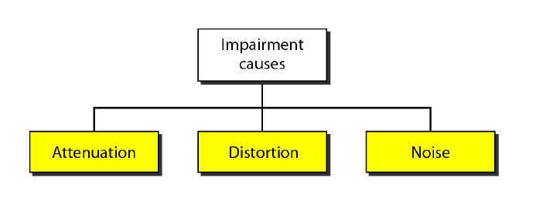

Slide 32
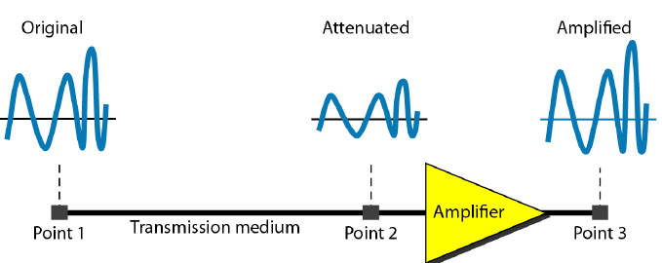
Attenuation
Attenuation
Unit –(Decibel)

Slide 33
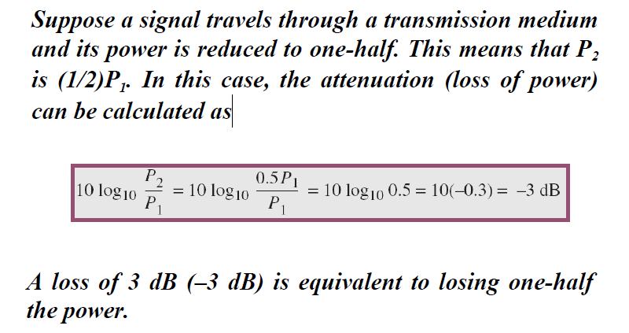

Slide 34
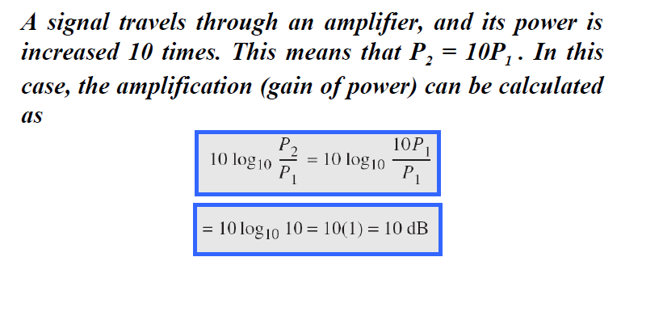

Slide 35
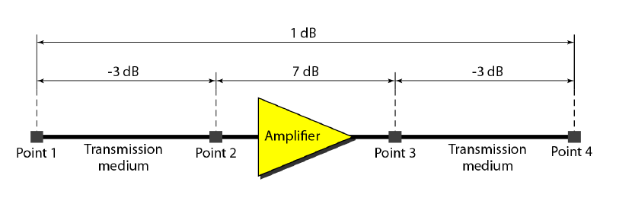
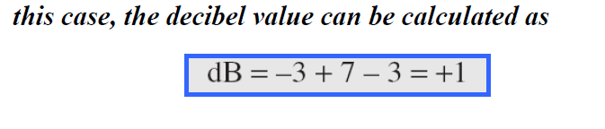
Q

Slide 36
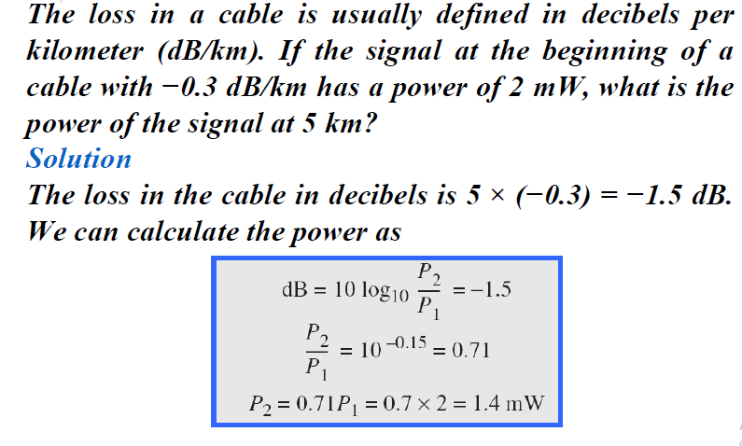

Slide 37
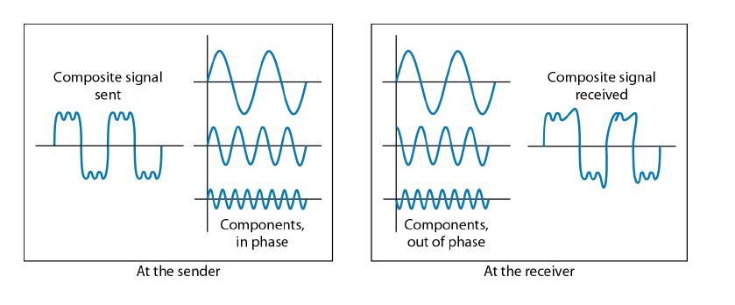
Distortion
Distortion means that the signal changes its form or shape. Distortion can occur in a
composite signal made of different frequencies.

Slide 38
Each signal component has its own
propagation speed (see the next section) through a medium and, therefore, its own
delay in arriving at the final destination.
Signal components at the receiver have phases different from what they had at the sender.

Slide 39
Noise
Noise is another cause of impairment. Several types of noise, such as thermal noise,induced noise, crosstalk, and impulse noise, may corrupt the signal.
Thermal noise is the random motion of electrons in a wire which creates an extra signal not originally sent by the transmitter. Induced noise comes from sources such as motors and appliances.
These devices act as a sending antenna, and the transmission medium acts as the receiving antenna. Crosstalk is the effect of one wire on the other. One wire acts as a sending antenna and the other as the receiving antenna.
Impulse noise is a spike (a signal with high energy in a very short time) that comes from power lines, lightning, and so on. shows the effect of noise on a signal.

Slide 40
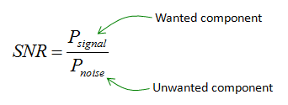

Slide 41
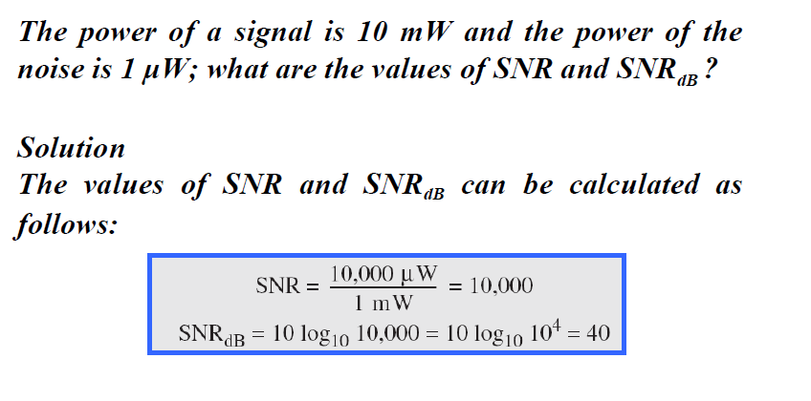

Slide 42
What is the bandwidth of a signal that can be decomposed into five sine waves with frequencies at 0, 20, 50, 100, and 200 Hz? All peak amplitudes are the same.
Draw the bandwidth.

Slide 43
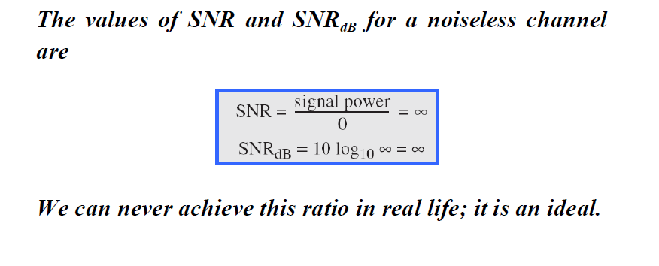
There are two types channel
1. Noiseless Channel
2. Noisy Channel

Slide 44
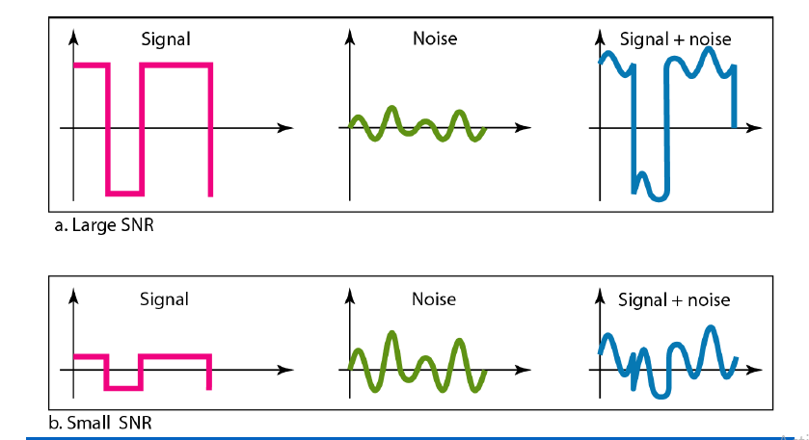
Two cases of SNR: a high SNR and a low SNR

Slide 45
DATA RATE LIMITS
A very important consideration in data communications is how fast we can send data, in bits per second, over a channel. Data rate depends on three factors:
1. The bandwidth available
2. The level of the signals
3. The quality of the channel (the level of noise)

Slide 46
Two theoretical formulas were developed to calculate the data rate
one by Nyquist for a noiseless channel.
another by Shannon for a noisy channel.

Slide 47
Noiseless Channel: Nyquist Bit Rate
For a noiseless channel, the Nyquist bit rate formula defines the theoretical maximum bit rate
BitRate = 2 x bandwidth x log2 L
In this formula, bandwidth is the bandwidth of the channel, L is the number of signal levels used to represent data, and BitRate is the bit rate in bits per second.
**Increasing the levels of a signal may reduce the reliability of the system.

Slide 48
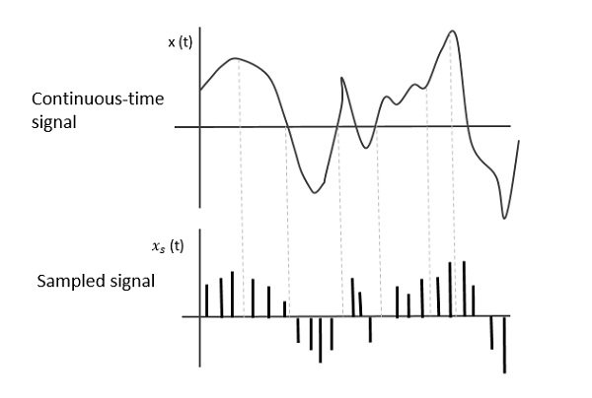
Nyquist theorem:
The Nyquist Theorem, also known as the sampling theorem, is a principle that is followed in the digitization of analog signals.
A bandlimited continuous-time signal can be sampled and perfectly reconstructed from its samples if the waveform is sampled over twice as fast as it's highest frequency component.

Slide 49
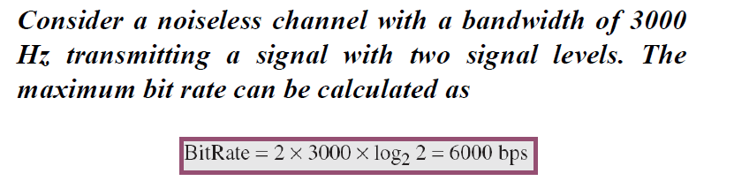
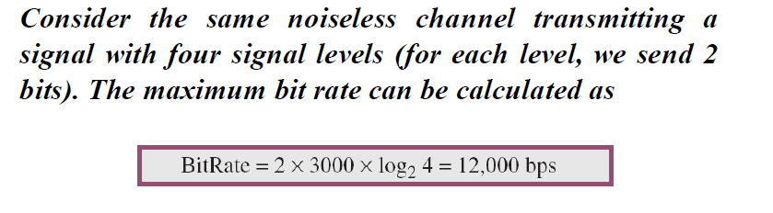

Slide 50
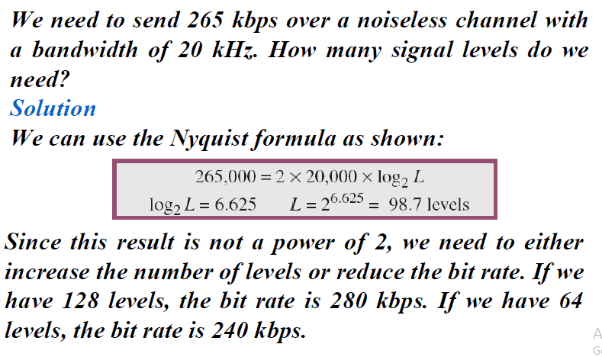

Slide 51

Noisy Channel: Shannon Capacity
In reality, we cannot have a noiseless channel; the channel is always noisy
Claude Shannon introduced a formula, called the Shannon capacity, to determine the theoretical highest data rate for a noisy channel:

Slide 52
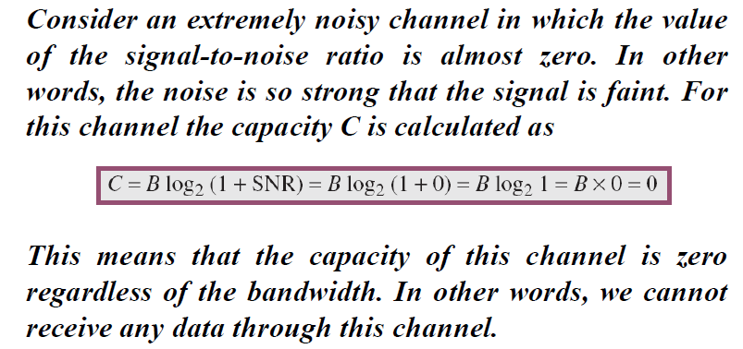

Slide 53
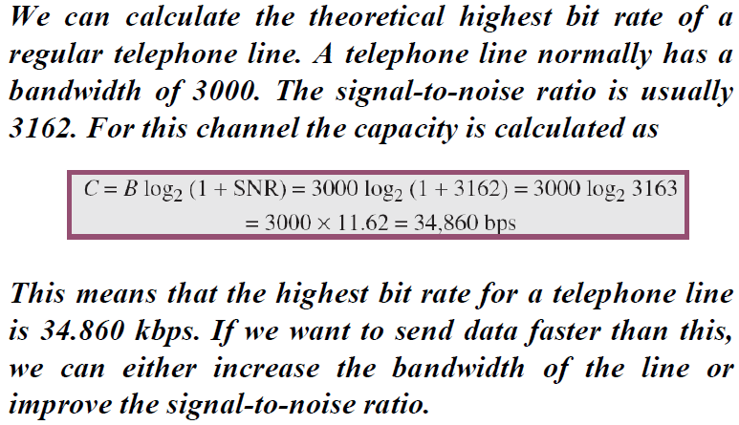

Slide 54
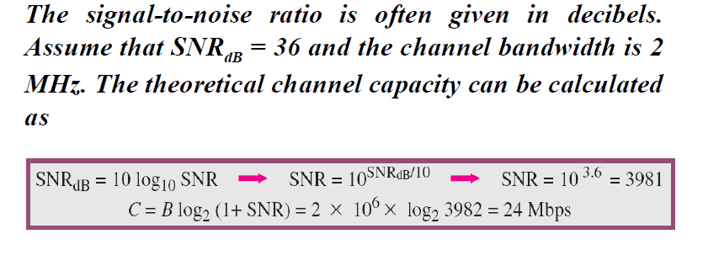
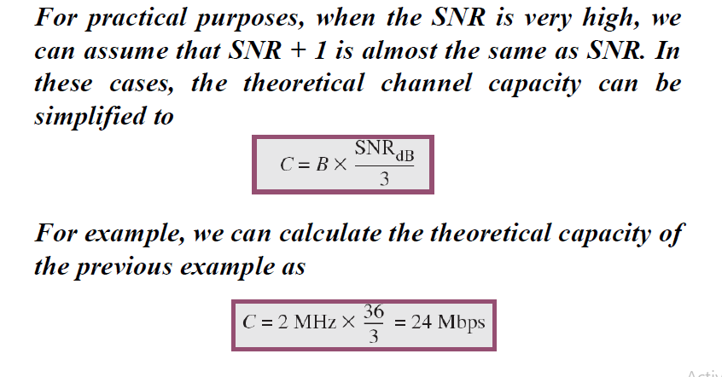

Slide 55
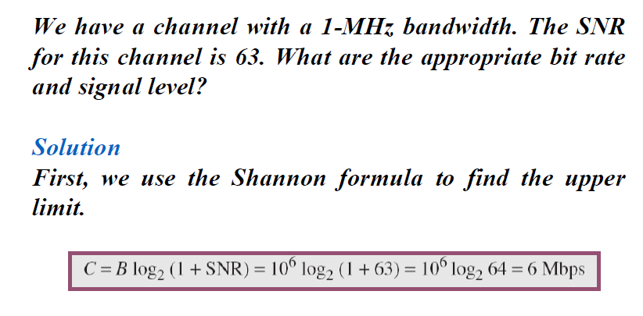

Slide 56
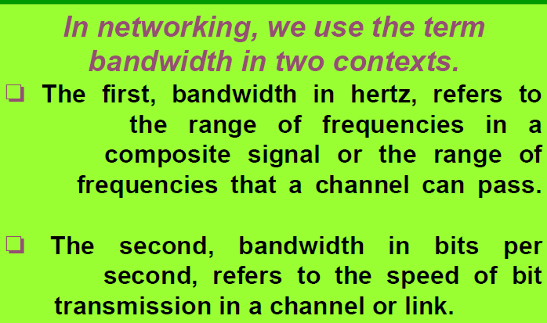
Performance of the network
One important issue in networking is the performance of the network—how good is it? One characteristic that measures network performance is bandwidth.

Slide 57
Throughput
The throughput is a measure of how fast we can actually A link may have a bandwidth of B bps, but we can only send T bps through this link with T always less than B.
In other words, the bandwidth is a potential measurement of a link; the throughput is an actual measurement of how fast we can send data.
For example, we may have a link with a bandwidth of 1 Mbps, but the devices connected to the end of the link may handle only 200 kbps. This means that we cannot send more than 200 kbps through this link. send data through a network.

Slide 58
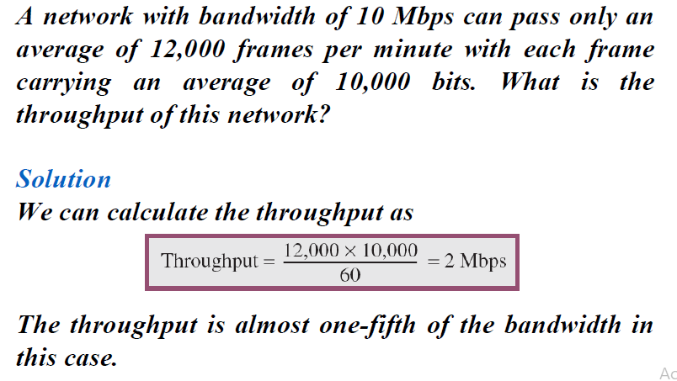

Slide 59
Latency (Delay)
The latency or delay defines how long it takes for an entire message to completely arrive at the destination from the time the first bit is sent out from the source.
latency is made of four components:
propagation time
transmission time,
queuing time
processing delay
Latency =propagation time +transmission time +queuing time + processing delay

Slide 60
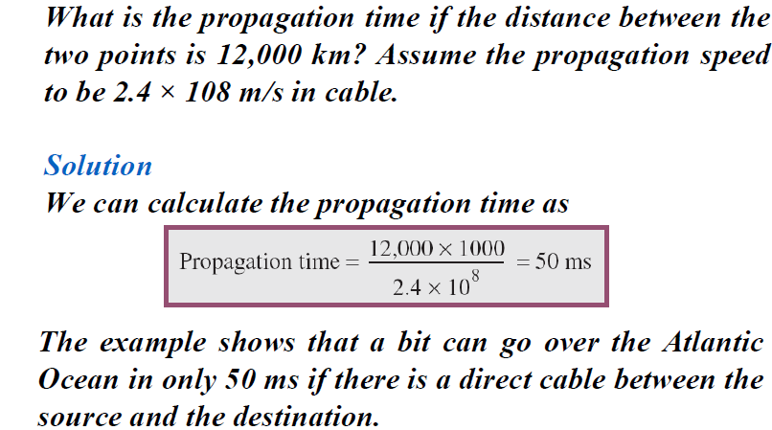

Slide 61
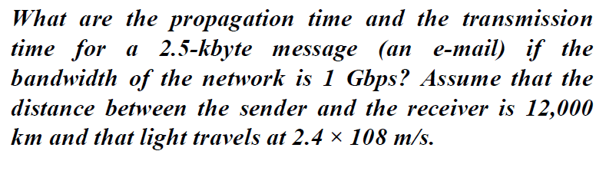

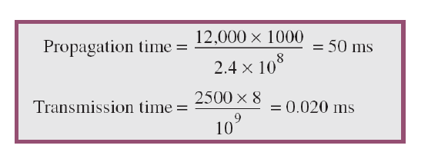

Slide 62
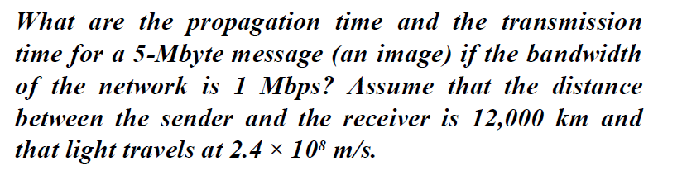
If the message is very long and the bandwidth is not very high, the dominant factor is the transmission time, not the propagation time

Slide 63
Queuing time
The third component in latency is the queuing time, the time needed for each intermediate
or end device to hold the message before it can be processed.
The queuing time is not a fixed factor; it changes with the load imposed on the network. When there is heavy traffic on the network, the queuing time increases. An intermediate device, such as a router, queues the arrived messages and processes them one by one.

Slide 64
Bandwidth-Delay Product
Bandwidth and delay are two performance metrics of a link.
The bandwidth-delay product defines
the number of bits that can fill the link.

Slide 65
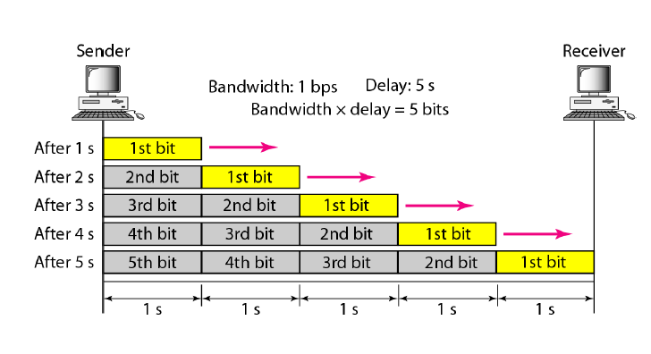
Case1

Slide 66
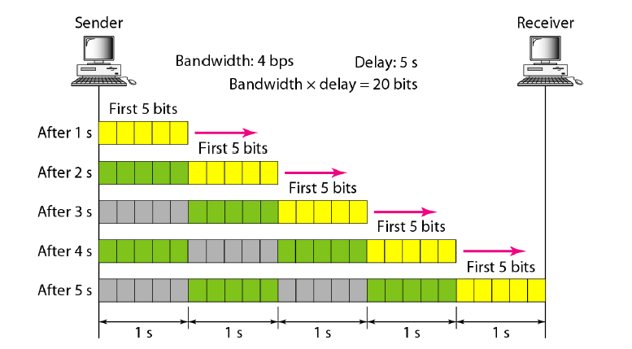
Case2

